Slide 1
Barren plateaus and how to avoid them
5/1/2022

Slide 2
References
McClean, Jarrod R., et al. "Barren plateaus in quantum neural network training landscapes." Nature communications 9.1 (2018): 1-6. [507 cites]
Grant, Edward, et al. "An initialization strategy for addressing barren plateaus in parametrized quantum circuits." Quantum 3 (2019): 214. [134 cites]
Zhao, Chen, and Xiao-Shan Gao. "Analyzing the barren plateau phenomenon in training quantum neural networks with the ZX-calculus." Quantum 5 (2021): 466. [16 cites]

Slide 3
Outline
What is barren plateuas?
Experiments
Ways to avoid barren plateuas

Slide 4
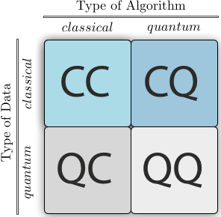
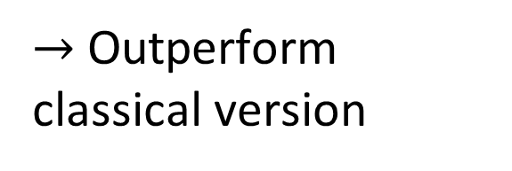
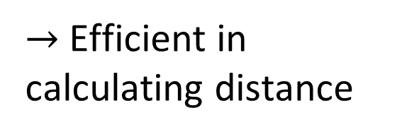
Quantum machine learning in NISQ era
Quantum KNN
Quantum Kmeans
Quantym SVM
$→$ Efficient in calculating distance
Quantum Neural Network: QRNN (2020), QuGAN(2020), QLSTM (2020), …
$→$ Outperform classical version
Notes:
this quantum version of LSTM converges faster, or equivalently, reaches a better accuracy, than its classical counterpart
QuGAN is able to achieve similar performance with 98.5% reduction on the parameter set when compared to classical GANs. With the same number of parameters, additionally, QuGAN outperforms other quantum based GANs in the literature for up to 125.0% in terms of similarity between generated distributions and original datasets

Slide 5
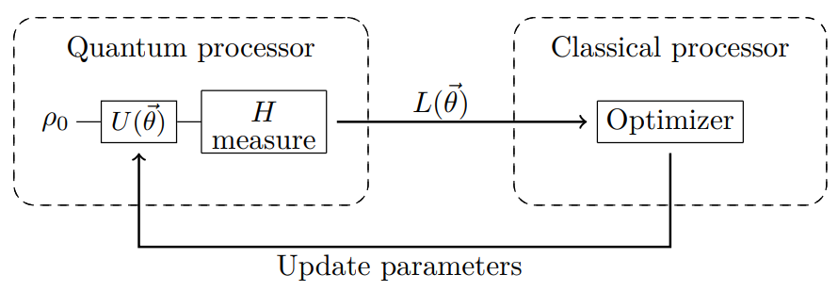
Hybrid quantum-classical algorithm

Slide 6
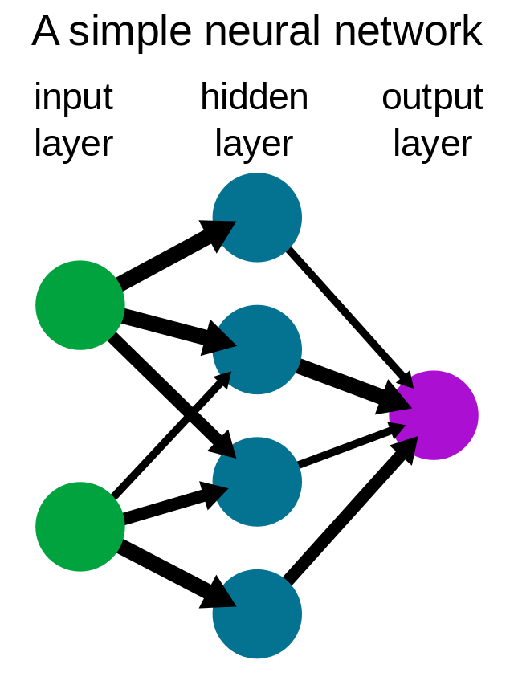
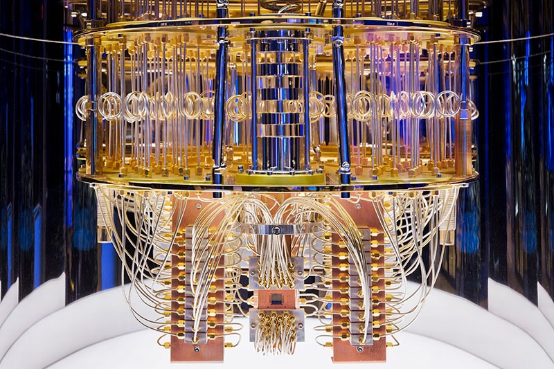
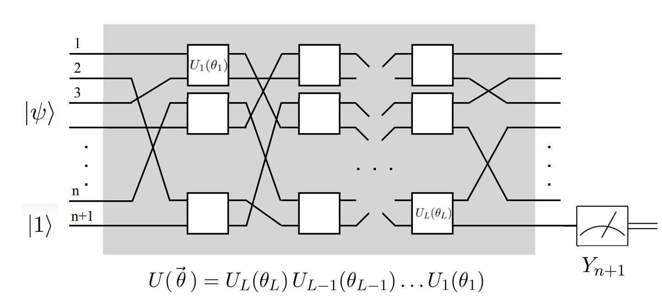
Quantum neural network (QNN)
Quantum computer
Quantum neural network
+
=

Slide 7
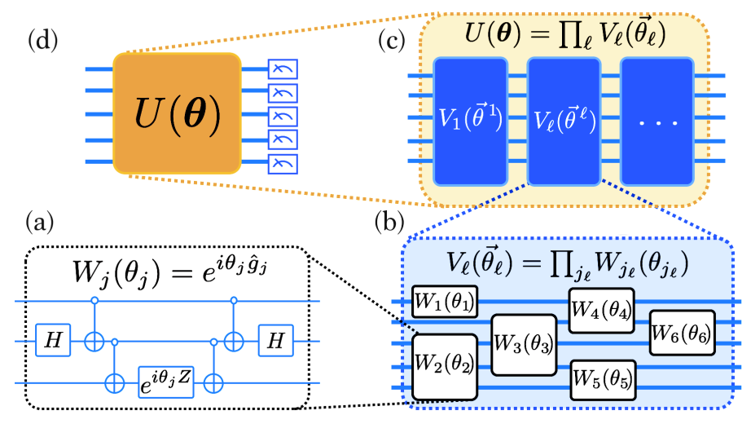
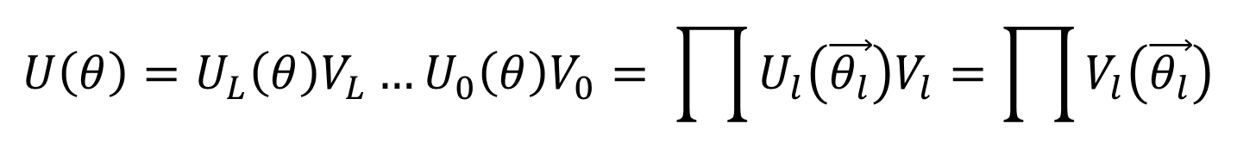
Quantum neural network (QNN)
$$U\left(θ\right)=U_{L}\left(θ\right)V_{L}…U_{0}\left(θ\right)V_{0}= \prod{U_{l}\left(\vec{θ_{l}}\right)V_{l}}=\prod{V_{l}\left(\vec{θ_{l}}\right)}$$
Broughton, Michael, et al. "Tensorflow quantum: A software framework for quantum machine learning." arXiv preprint arXiv:2003.02989 (2020).

Slide 8
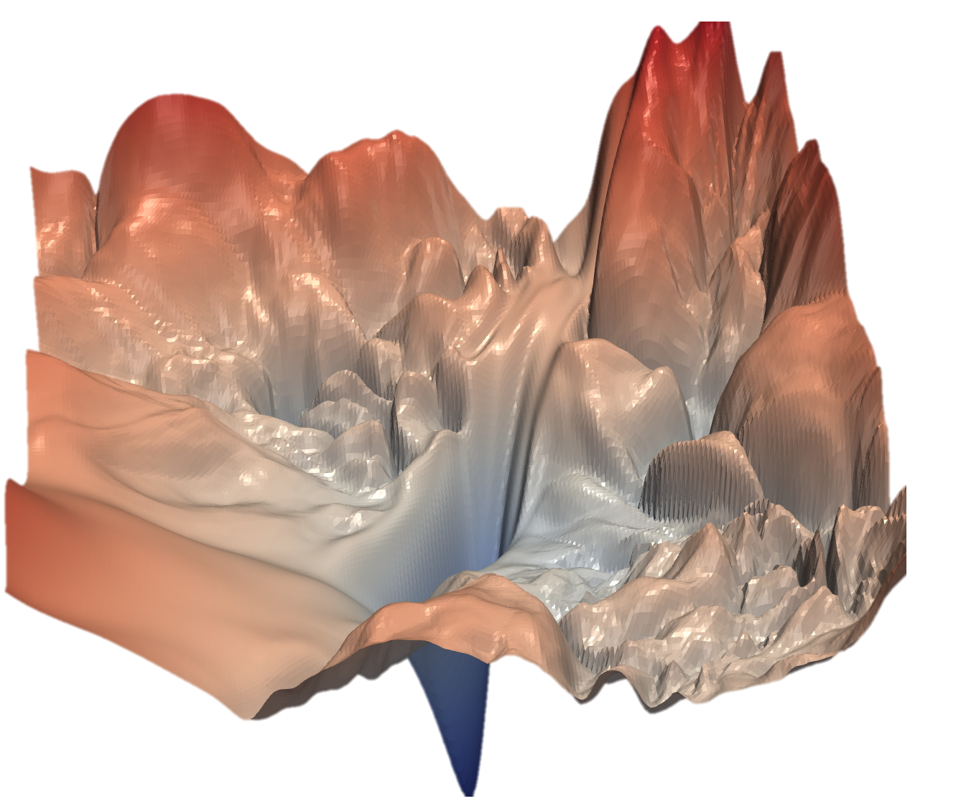
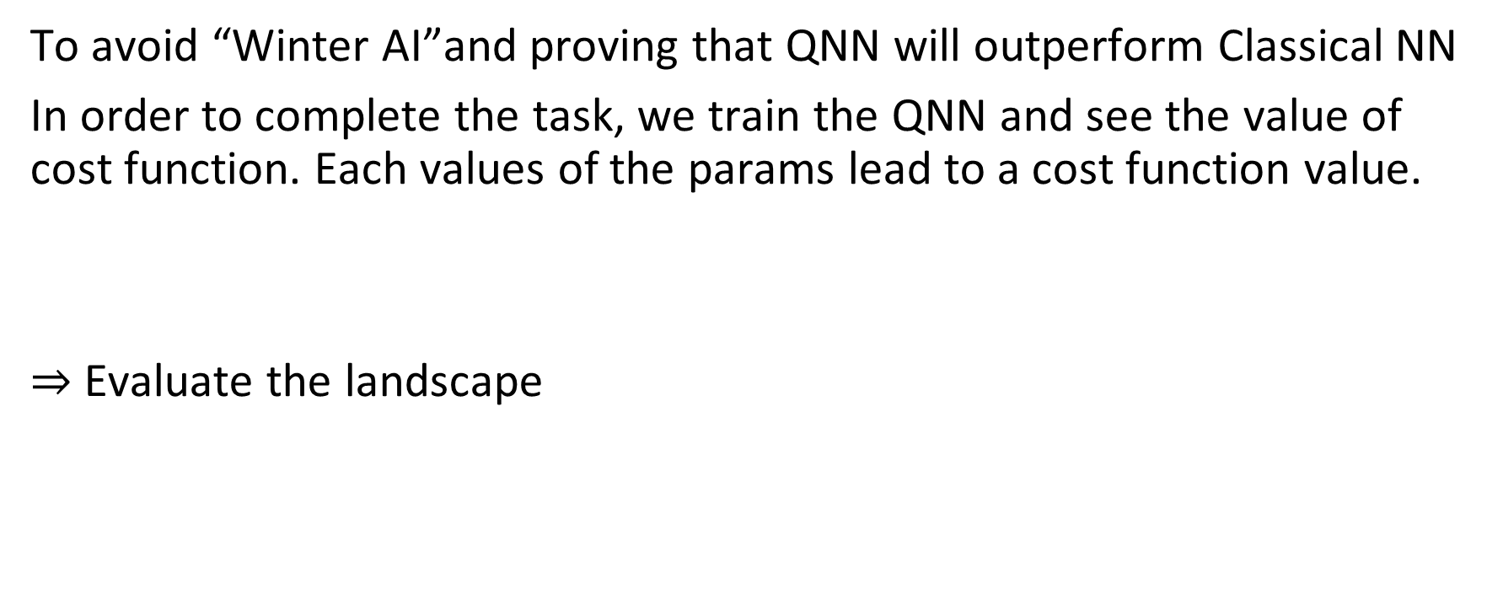
Analyze the trainability of QNN
To avoid “Winter AI”and proving that QNN will outperform Classical NN
In order to complete the task, we train the QNN and see the value of cost function. Each values of the params lead to a cost function value.
$⇒$ Evaluate the landscape

Slide 9
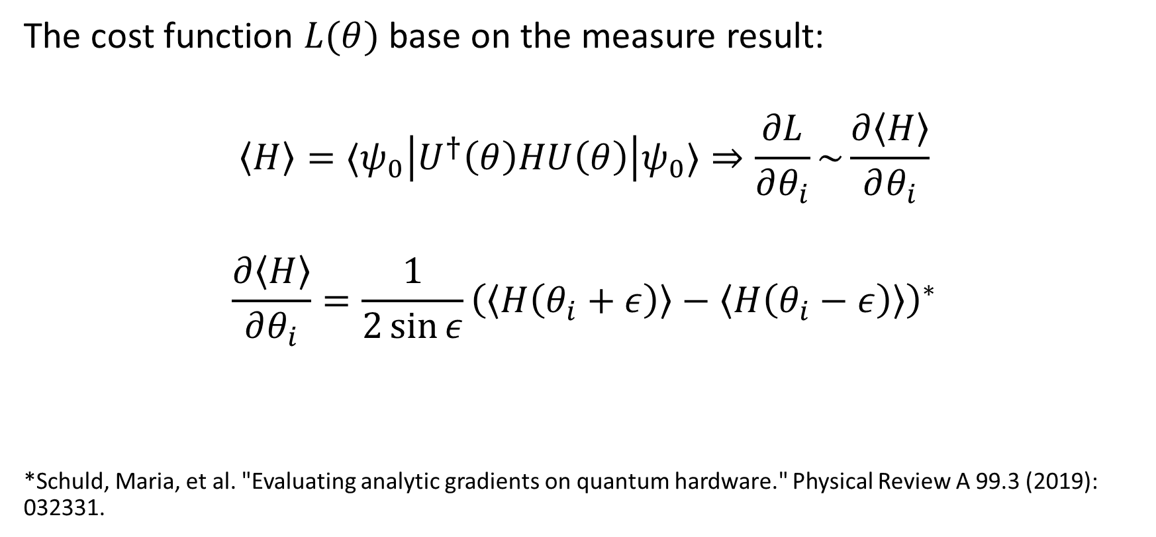
Quantum neural network
The cost function $L(θ)$ base on the measure result:
$$\left\langle H\right\rangle =⟨ψ_{0}\left|U^{†}\left(θ\right)HU\left(θ\right)\right|ψ_{0}⟩⇒\frac{∂L}{∂θ_{i}}\sim \frac{∂\left\langle H\right\rangle }{∂θ_{i}}$$
$$\frac{∂\left\langle H\right\rangle }{∂θ_{i}}=\frac{1}{2\sin{ε}}{\left(\left\langle H\left(θ_{i}+ε\right)\right\rangle −\left\langle H\left(θ_{i}−ε\right)\right\rangle \right)}^{∗}$$
*Schuld, Maria, et al. "Evaluating analytic gradients on quantum hardware." Physical Review A 99.3 (2019): 032331.

Slide 10
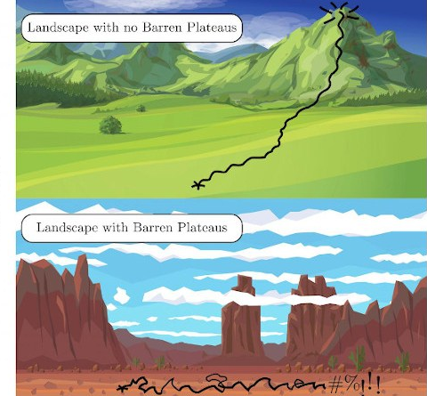
Barren platueas

Slide 11
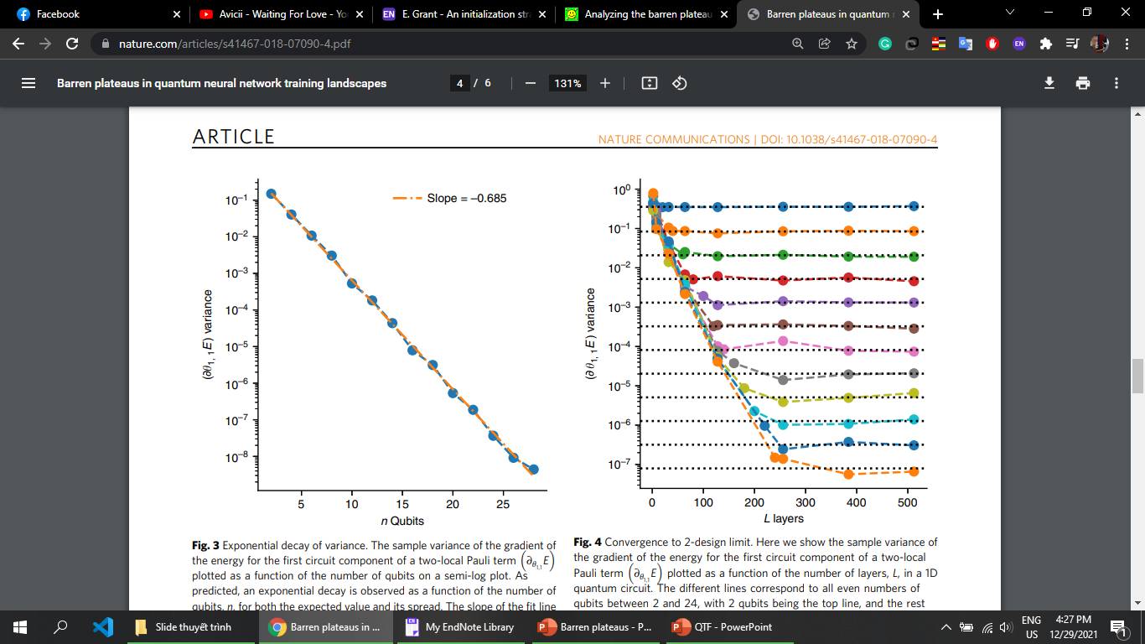
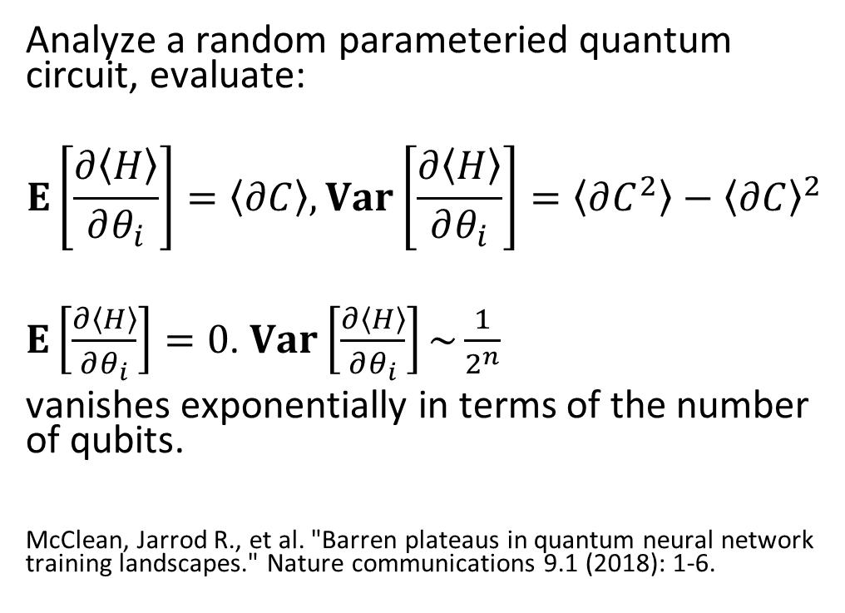
Barren platueas
Analyze a random parameteried quantum circuit, evaluate:
$$E\left[\frac{∂\left\langle H\right\rangle }{∂θ_{i}}\right]=\left\langle ∂C\right\rangle ,Var\left[\frac{∂\left\langle H\right\rangle }{∂θ_{i}}\right]=\left\langle ∂C^{2}\right\rangle −{\left\langle ∂C\right\rangle }^{2}$$
$E\left[\frac{∂\left\langle H\right\rangle }{∂θ_{i}}\right]=0$. $Var\left[\frac{∂\left\langle H\right\rangle }{∂θ_{i}}\right]\sim \frac{1}{2^{n}}$
vanishes exponentially in terms of the number of qubits.
McClean, Jarrod R., et al. "Barren plateaus in quantum neural network training landscapes." Nature communications 9.1 (2018): 1-6.

Slide 12
Barren platueas
Connection with the classical NN, the same phenomenon Vanishing gradient (in case of “deep” NN):
+ New architechture: Residual NN (Resnet)
+ Use new activation function: ReLU and its variants
+ Use new weight initialization: Glorot, He
+ Batch normalization

Slide 13
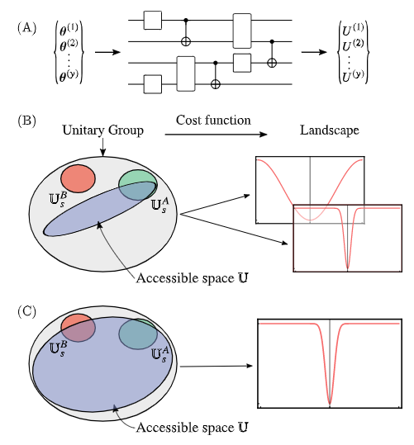
Barren platueas
Less parameter / layer may be better!
(B) A low-expressibility ansatz contains solu-tions to problem A but not to B, while a high-expressibility ansatz as in
(C) contains solutions to both problems. Low-expressibility ansätze can lead to both small and large costgradients. On the other hand, high-expressibility ansätze leadto predominantly flat cost landscapes, and thus are generallyhard to train

Slide 14
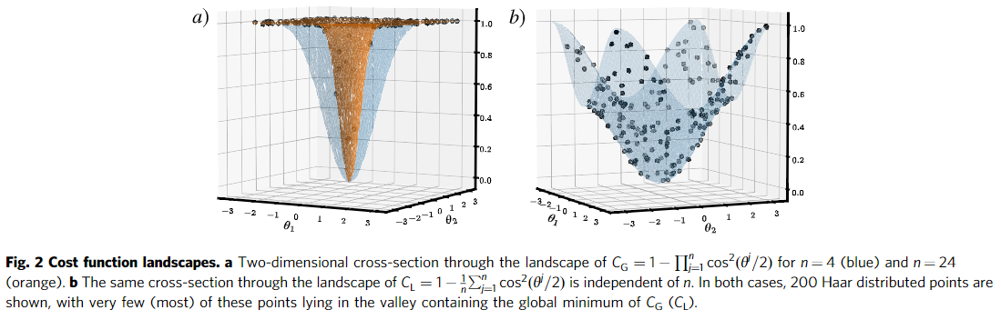
Barren platueas in shallow circuit
Now we depend on the cost function
Global cost
Local cost
Cerezo, M., Sone, A., Volkoff, T. et al. Cost function dependent barren plateaus in shallow parametrized quantum circuits. Nat Commun 12, 1791 (2021)

Slide 15
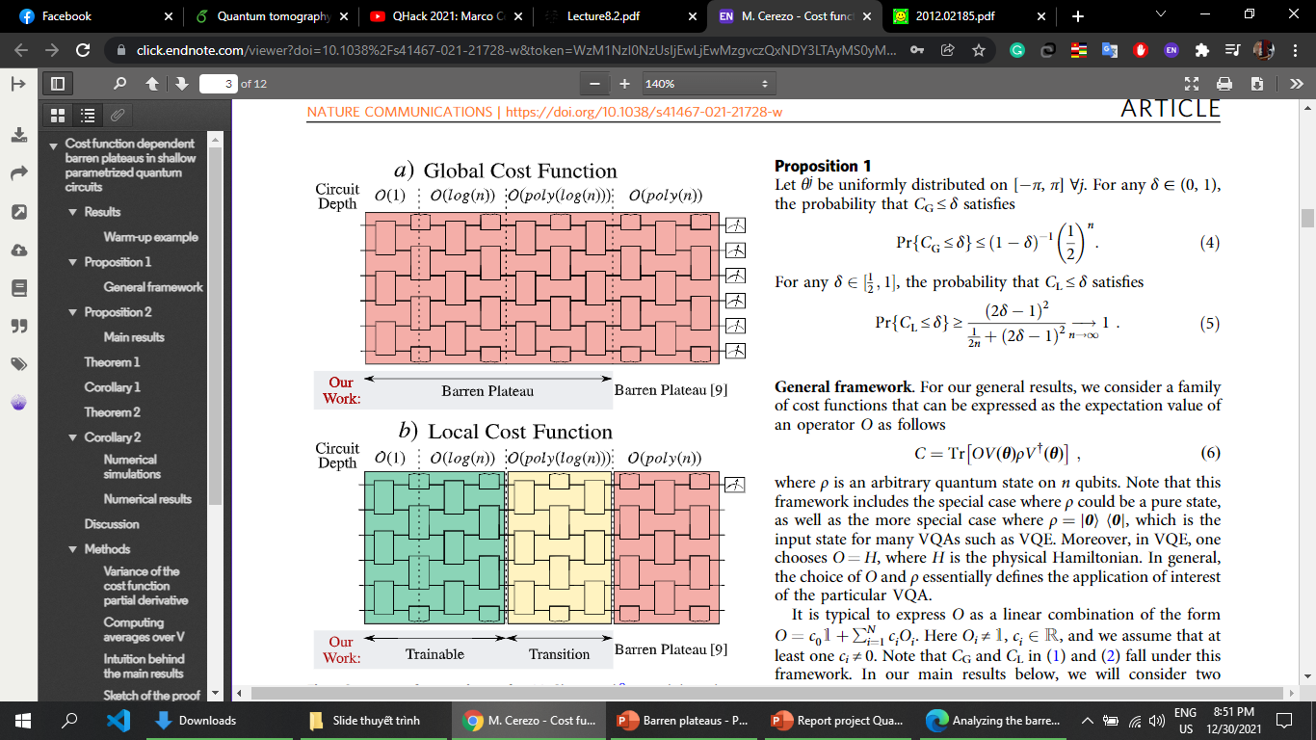
Barren platueas in shallow circuit

Slide 16
Now we have two sources of BP
BP can comes from everywhere !
Expressibility
Globality
How to know any QNN architecture has BP?
Plot the landscape (But how to choose variables?)
Sampling random set of parameter and see the variance (May be take a lot of computation time)

Slide 17
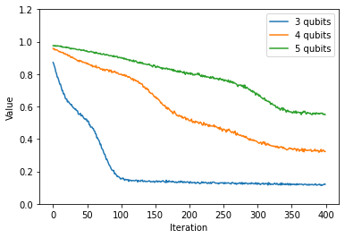
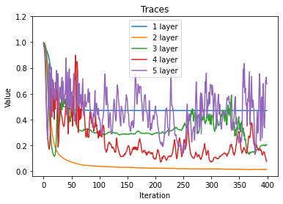
Experiments
Loss value in case 3 – 5 qubits
Loss value in case 3 qubits, 1 – 5 layers

Slide 18
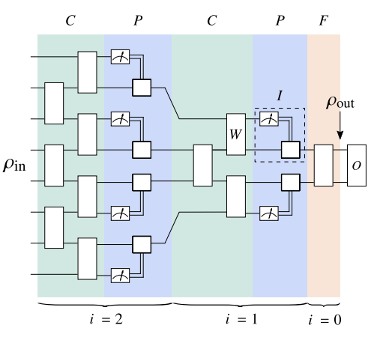
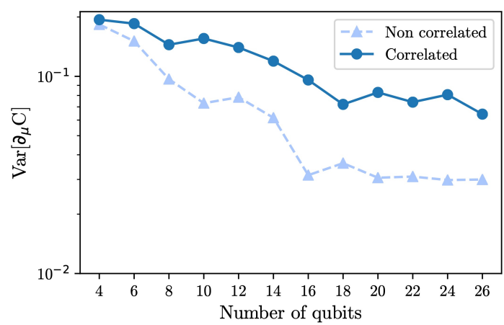

No BP in Quantum convolutional networks
QCNNs are “naturally” shallow:
Variance of the gradient has sub-exponential scaling with.
Correlations between variational blocks lead to larger variances.
Pooling-based QCNN is also trainable.
$Var\left[\frac{∂\left\langle H\right\rangle }{∂θ_{i}}\right]>F_{n}\left(L,l\right)$
Pesah, Arthur, et al. "Absence of barren plateaus in quantum convolutional neural networks." Physical Review X 11.4 (2021): 041011.

Slide 19
No BP in Quantum convolutional networks
QCNNs are “naturally” shallow:
Variance of the gradient has sub-exponential scaling with.
Correlations between variational blocks lead to larger variances.
Pooling-based QCNN is also trainable.
$Var\left[\frac{∂\left\langle H\right\rangle }{∂θ_{i}}\right]>F_{n}\left(L,l\right)$
Pesah, Arthur, et al. "Absence of barren plateaus in quantum convolutional neural networks." Physical Review X 11.4 (2021): 041011.

Slide 20
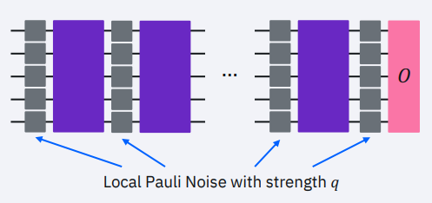
Noise-induced BP
Wang, S., Fontana, E., Cerezo, M., Sharma, K., Sone, A., Cincio, L., Coles, P.J., 2021. Noise-induced barren plateaus in variational quantum algorithms. Nature Communications 12

Slide 21
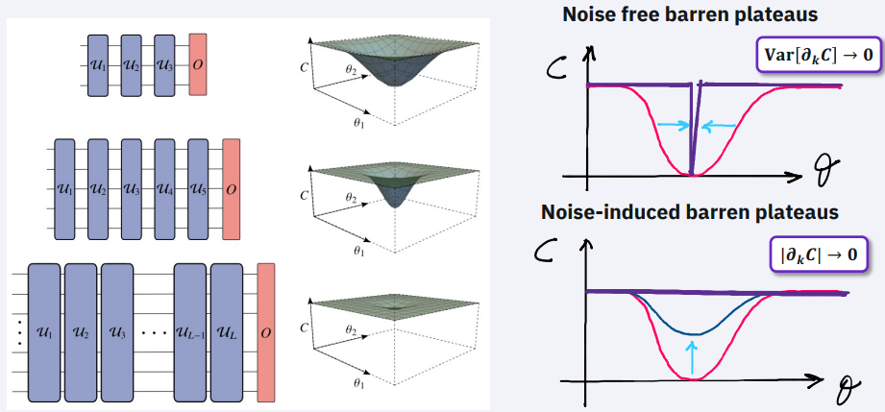
Noise-induced BP
Wang, S., Fontana, E., Cerezo, M., Sharma, K., Sone, A., Cincio, L., Coles, P.J., 2021. Noise-induced barren plateaus in variational quantum algorithms. Nature Communications 12
Notes:
Làm điểm minimun trồi lênn

Slide 22
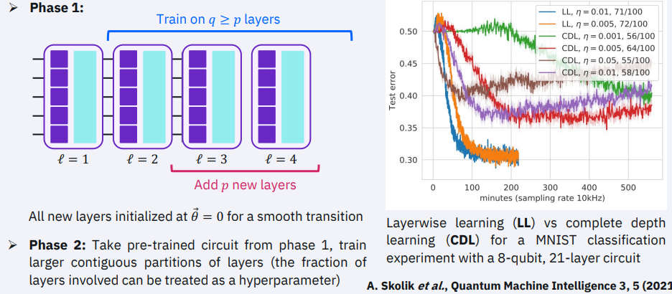
Laye-wise learning
Notes:
Làm điểm minimun trồi lênn

Slide 23
Additional methods
Use structured initial guesses, such as those adopted in quantum simulation.
Training strategy: pre-train, layer by layer, smart initialize parameter

Slide 24
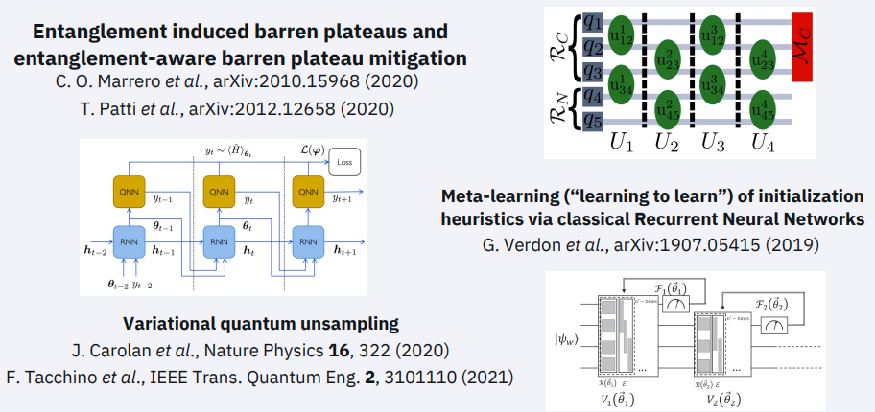
Additional methods

Slide 25
Future works
Can we apply these technique in case of classical NN? And vice versa?

Slide 26
Thanks for listening!!!

Slide 27

Haar measure
Single qubit Haar measure
$$U3\left(θ,φ,λ\right)=\left[\begin{matrix}\cos{\frac{θ}{2}} & e^{−iλ}\sin{\frac{θ}{2}} \\ e^{iφ}\sin{\frac{θ}{2}} & e^{i(λ+φ)}\cos{\frac{θ}{2}}\end{matrix}\right]$$
Let $θ,φ,λ$ uniform randomly in $\left(0,2π\right)$

Slide 28
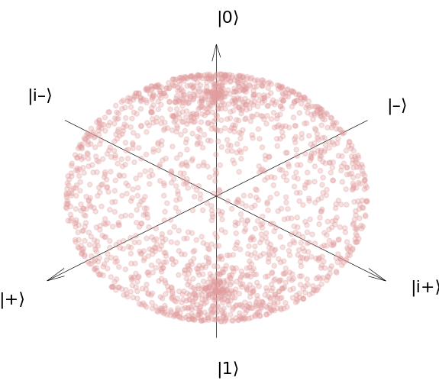
Haar measure
Despite the input parameters being uniform, the output is very much not uniform

Slide 29
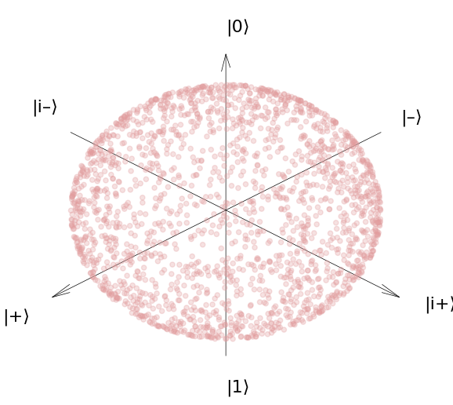

Haar measure
Change:
$ℙ\left(θ\right)=\sin{θ}$
Haar measure:
$dμ_{2}=\sin{θ}dθdωdφ$

